Slide 1
DIGITAL IMAGE PROCESSING PRESENTATION CS-504 BS-CS 6th
M Ahtesham Sarwar 2019-ag-6068
M Khawar Azeem 2019-ag-6067
Nabeel Ur Rehmaan 2019-ag-6078

Slide 2
LOG TRNASFORMATION
IMAGE ENHANCEMNT

Slide 3
Log Transformation
Logarithmic transformation of an image is one of the gray level image transformations.
It means replacing all pixel values, present in the image, with its logarithmic values.
Used for Image Enhancement.
As it expands dark pixels of the image as compared to higher pixel values.

Slide 4
Log Transformation
Formula for log Transformation:
S = c * log ( 1 + r)
Where,
R = input pixel value
C = scaling constant
S = output pixel value

Slide 5
Log Transformation
The value of ‘c’ is chosen such that we get the maximum output value corresponding to the bit size used.
Formula for calculating ‘c’:
c = 255 / (log ( 1 + max_input_pixel_value))

Slide 6
Applications
Expands the dark pixels in the image while compressing the brighter pixels
Compresses the dynamic range (display of Fourier transform).

Slide 7
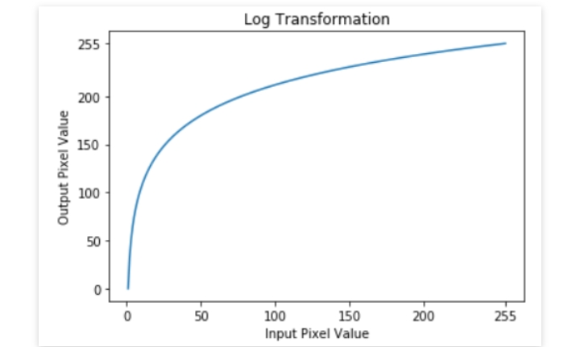
Explanation
Clearly, the low intensity values in the input image are mapped to a wider range of output levels. The opposite is true for the higher values.

Slide 8
Explanation
When we apply log transformation in an image and any pixel value is ‘0’ then its log value will become infinite. That’s why we are adding ‘1’ to each pixel value at the time of log transformation so that if any pixel value is ‘0’, it will become ‘1’ and its log value will be ‘0’.

Slide 9
Explanation
Dynamic range refers to the ratio of max and min intensity values. When the dynamic range of the image is greater than that of displaying device ( like in Fourier transform), the lower values are suppressed. To overcome this issue, we use log transform. Log transformation first compresses the dynamic range and then up-scales the image to a dynamic range of the display device. In this way, lower values are enhanced and thus the image shows significantly more details.

Slide 10
Explanation
Thus a logarithmic transform is appropriate when we want to enhance the low pixel values at the expense of loss of information in the higher pixel values.
Be careful, if most of the details are present in the high pixel values, then applying the log transform results in the loss of information as show below:

Slide 11
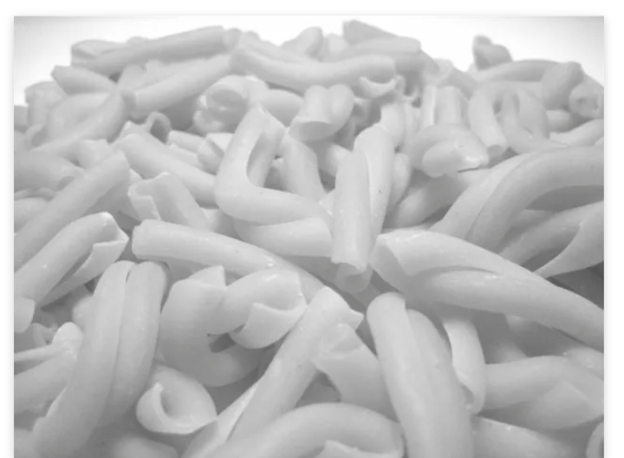

Explanation
Before
After

Slide 12

Any Questions?

